Slide 1
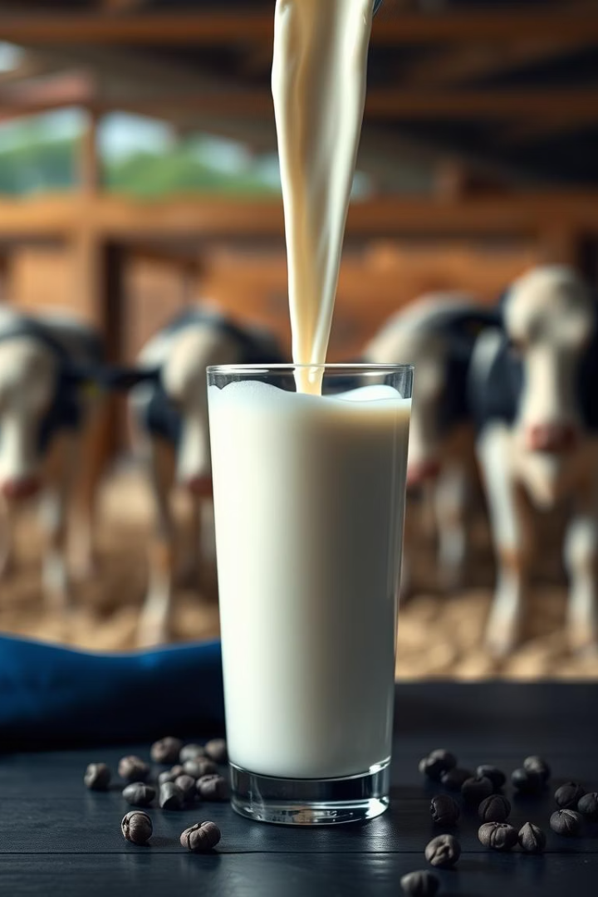
A Machine Learning Framework for Predicting Milk Quality
Milk quality assurance is vital for public health, regulatory compliance, and economic sustainability in the dairy industry. This study introduces a machine learning framework to predict milk quality using key physicochemical and sensory features such as pH, temperature, taste, odor, fat content, turbidity, and color. The dataset includes 1059 instances and eight features, preprocessed to handle missing values and normalize data.
Multiple supervised models were tested, with the Random Forest classifier achieving outstanding accuracy, precision, and recall of 99.7%, effectively classifying milk into low, medium, or high quality categories. This approach offers a scalable solution for automated milk quality assessment.
Presented by
Atul Kumar

Slide 2
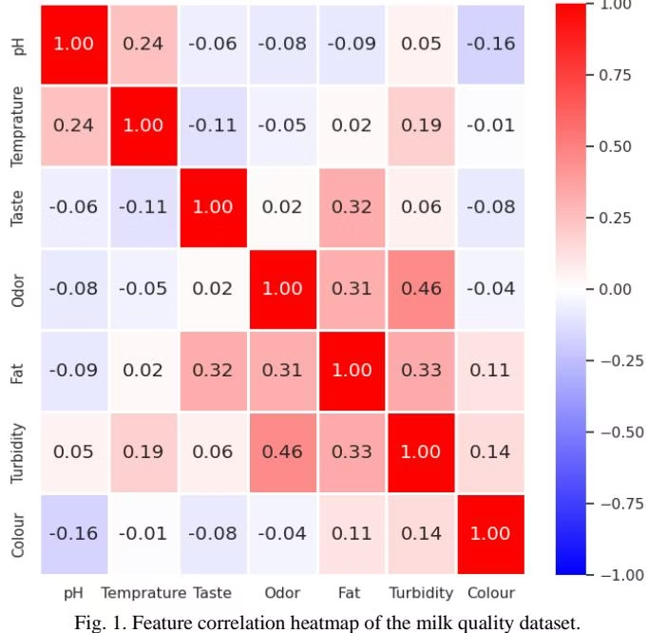

Introduction to Milk Quality Prediction
Milk is a widely consumed, nutritionally essential product whose quality affects consumer health and economic value. Traditional manual and lab-based quality assessments are slow and error-prone. Machine learning offers automated, accurate, and scalable alternatives for real-time evaluation.
This study uses a Kaggle dataset with 1059 samples and seven features—pH, temperature, taste, odor, fat, turbidity, and color—to classify milk quality into low, medium, and high grades. Preprocessing includes label encoding and normalization to prepare data for modeling.

Slide 3
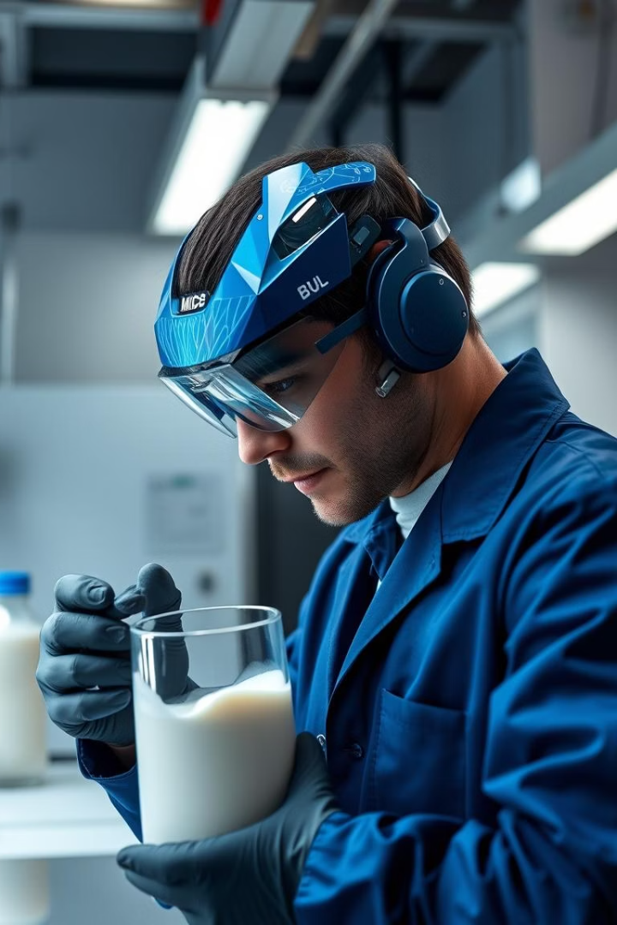
Literature Review on Milk Quality Assessment
Traditional vs ML Methods
Model Comparisons
Studies show decision trees, k-NN, SVM, and ensemble methods like Random Forest perform well. Feature interaction and preprocessing are crucial for accuracy.
Conventional chemical and microbial tests are accurate but slow and variable. ML models automate classification using physicochemical features like pH, odor, and fat.
Research Gaps
Few studies compare multiple classifiers on structured milk datasets. This work fills that gap by evaluating five models on seven key features.

Slide 4
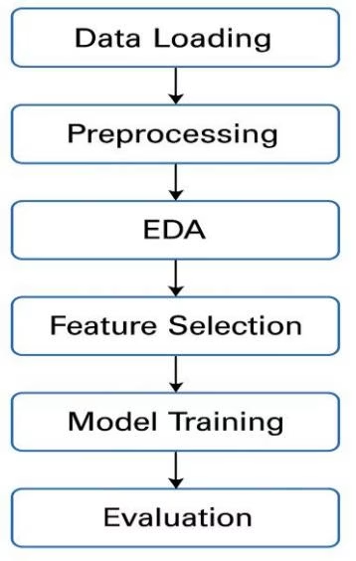





Dataset and Methodology Overview
Data Collection
Dataset from Kaggle with 1059 milk samples,
including pH, temperature, taste, odor, fat, turbidity, color,
and quality grade (Low, Medium, High).
Preprocessing
No missing values found.
Label encoding applied to categorical variables.
Numerical features normalized using MinMaxScaler.
Exploratory Data Analysis
Balanced class distribution and feature distributions analysed with
histograms and box plots. Skewness and outliers identified in fat, turbidity, and color.
Feature Selection & Modeling
All features retained based on correlation analysis.
Five classifiers trained:
Logistic Regression, Decision Tree, Random Forest, KNN, and Gaussian Naive Bayes.
Evaluation
Metrics include accuracy, precision, recall,
and F1-score with 5-fold cross-validation and 70-30 train-test split.

Slide 5
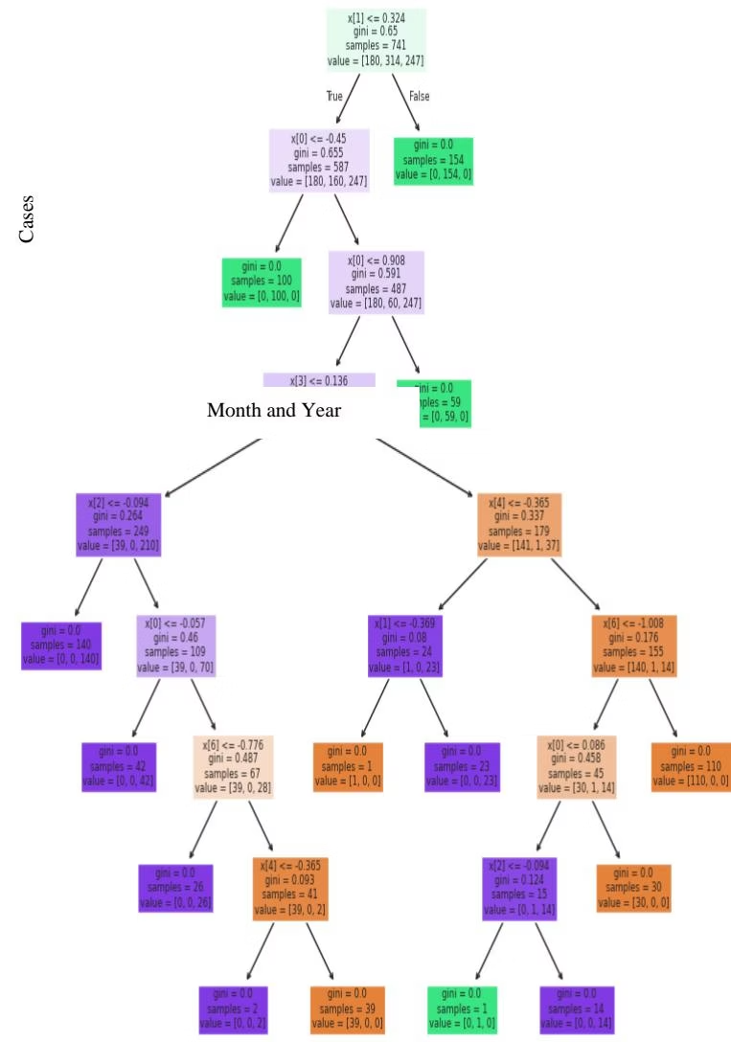
Results and Model Performance
The Random Forest classifier achieved the highest accuracy of 99.7%, with precision, recall, and F1-score all at 0.997. Decision Tree and KNN models also performed well with 99.4% accuracy. Gaussian Naive Bayes and Logistic Regression showed lower accuracy at 90.3% and 85.2%, respectively.
While Random Forest excels in accuracy, its black-box nature limits interpretability. The Decision Tree model offers transparent decision rules, highlighting key features like fat, odor, and pH influencing classification.

Slide 6

Deployment Pipeline
Containerization
Version Control
The project is containerized using Docker to ensure consistent environments and easy deployment.
Codebase is maintained in a GitHub repository, facilitating collaboration and version tracking.
Automation
A webhook created with Ngrok triggers Jenkins pipelines to auto-build and deploy the application on every GitHub push.

Slide 7
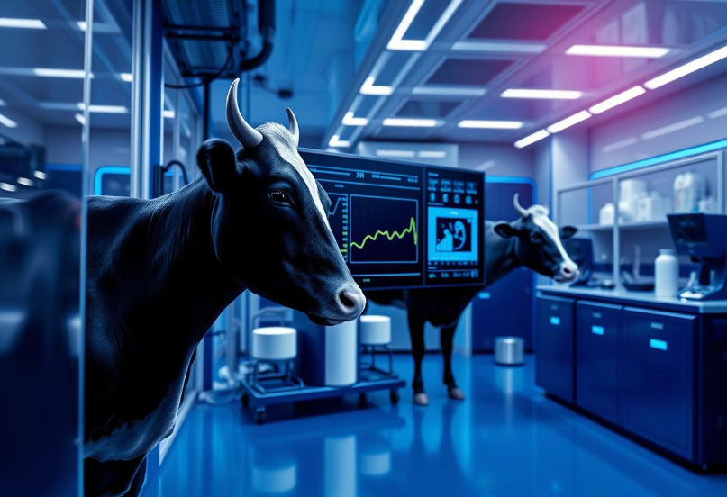
Conclusion and Future Directions
This study demonstrated a machine learning framework for milk quality prediction using physicochemical and sensory features. The Random Forest model achieved superior accuracy of 99.7%, outperforming other classifiers. Decision Trees offer interpretability, valuable for regulatory compliance.
Future work includes integrating real-time parameters like microbial counts, validating models on diverse datasets, exploring deep learning and hybrid ensembles, and applying explainable AI techniques to enhance transparency.

Slide 8
Thank You
Appreciation
Collaboration
Next Steps
Thank you for your time and attention throughout the presentation.
We welcome your questions, feedback, and future partnership opportunities.
Looking forward to advancing milk quality prediction together with you.

